Slide 1

Automated Resume Filtering Using Machine Learning and NLP
AI Internship Project at Mentorness
NIDHI SHETTY
09-06-2024

Slide 2

INTRODUCTION
Traditional resume screening is time-consuming and prone to human error.
Objective: Develop an automated system for filtering and ranking resumes based on job descriptions using ML and NLP.

Slide 3

PROBLEM STATEMENT
Manually reviewing resumes is inefficient and inconsistent.
Need for a solution that can quickly and accurately filter resumes.

Slide 4

Automated Database Search:
Identifies resumes matching job descriptions.
Intelligent Scoring Mechanism:
Ranks resumes based on relevance.
Efficiency:
Reduces manual effort required to review resumes.
Manual Verification:
Allows final stage manual review.
Advanced ML and NLP:
Uses TF-IDF vectorization and cosine similarity.
KEY FEATURES

Slide 5

TECHNIQUES USED
TF-IDF Vectorization: Converts text to numerical features.
Cosine Similarity: Measures similarity between job descriptions and resumes.
Natural Language Processing (NLP): Cleans and processes text data.

Slide 6

CODE OVERVIEW
Libraries and Setup: Importing required libraries.
Helper Functions: Extracting and cleaning text from PDFs.
Directory Paths: Setting up directories for job descriptions and resumes.
Text Extraction: Extracting and cleaning text from PDFs.
Matching Resumes: Computing similarity scores and ranking resumes.

Slide 7
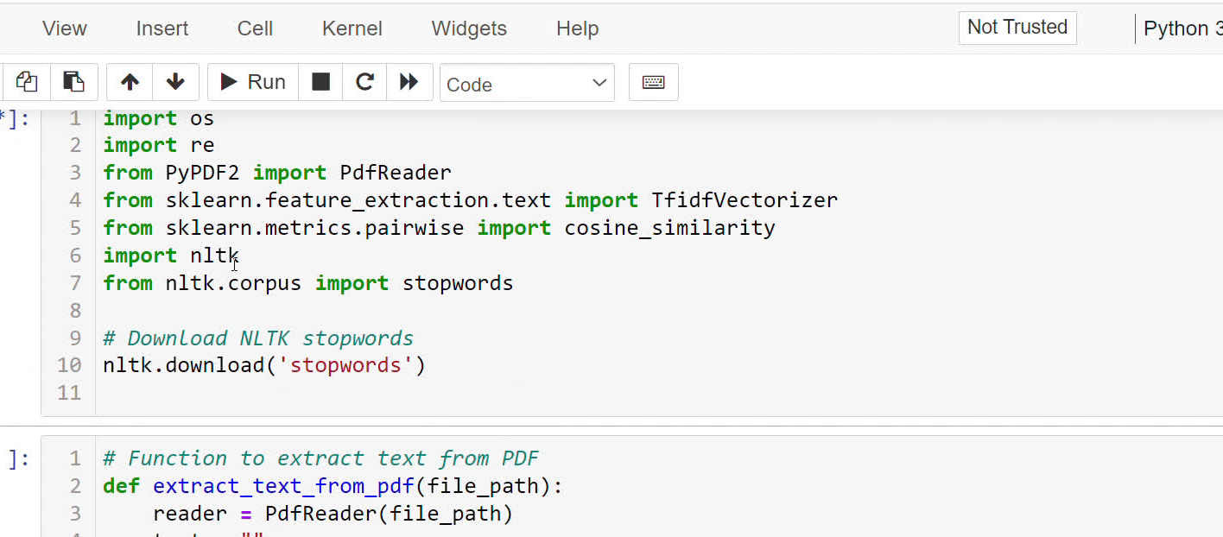
PERFORMANCE:

Slide 8


CONCLUSION
SUCCESSFULLY DEVELOPED AN AUTOMATED SYSTEM FOR RESUME FILTERING.
LEVERAGED MACHINE LEARNING AND NLP TO ENHANCE RECRUITMENT EFFICIENCY.
FUTURE IMPROVEMENTS COULD INCLUDE MORE SOPHISTICATED NLP TECHNIQUES AND A USER INTERFACE.

Slide 9
THANK YOU

